Slide 1

Probability
CSE422: Artificial Intelligence
You would probably need it

Slide 2
Motivation
Why do we need probability in AI?
To be certain of how uncertain we are.
Applications:
Speech Recognition
Object Tracking
Diagnostics
Genetics
… and countless others!
To ensure that STA201 does not go to waste

Slide 3
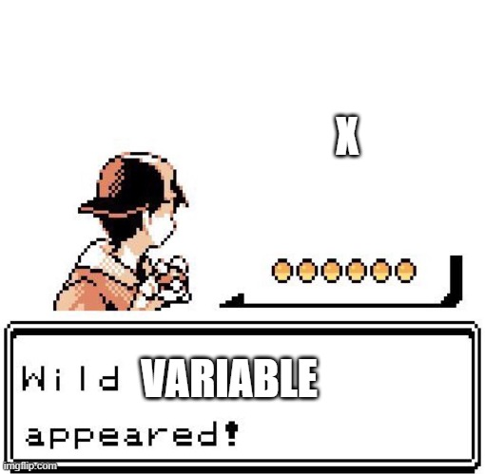
Random Variables

Slide 4
Random Variables
Random variables are a way to represent an event
The values of the variable are the possible scenarios that can take place in the event
A probability of occurrence is associated with each scenario
The sum of probability of all the scenarios in the event is always 1

Slide 5
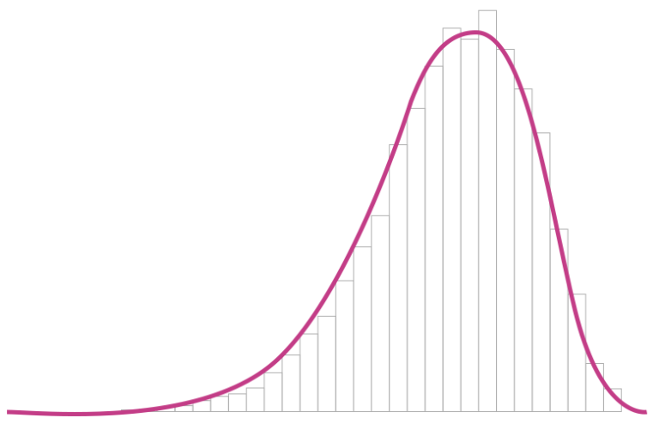
Random Variables
Discrete Random Variable
Continuous Random Variable
Let X be a random variable which represents the event how you are feeling right now
P(X = Bored) = 0.15
P(X = Excited) = 0.05
P(X = Sleepy) = 0.1
P(X = Depressed because you still have 30+ more lectures to watch) = 0.70
Let Y be a random variable which represents the score that you will receive in the next quiz

Slide 6
Probability Distributions
It is the distribution of the probabilities of each of the scenarios of the event.
Let X be a random variable which represents the event how you are feeling right now
Let Y be a random variable which represents the score that you will receive in the next quiz
P(X)
Bored | 0.15
Excited | 0.05
Sleepy | 0.1
Depressed because you still have 30 more lectures to watch | 0.70

Slide 7
Joint Distributions
These are probability distributions where two or more random variables are being considered.
Will I eat right now?
Considerations:
Am I hungry right now?
Am I bored right now?
Am I going to stream a movie/series right now?

Slide 8
Joint Distributions
RV H represents if I am hungry and it assumes the following values:
Yes represented by +h
No represented by -h
RV B represents if I am bored and assumes the following values:
Yes represented by +b
No represented by -b
RV S represents if I am going to stream and assumes the following values:
Yes represented by +s
No represented by -s

Slide 9
Joint Distributions
H | B | S | P
+h | +b | +s | 0.44
+h | +b | -s | 0.15
+h | -b | +s | 0.14
+h | -b | -s | 0.07
-h | +b | +s | 0.10
-h | +b | -s | 0.04
-h | -b | +s | 0.05
-h | -b | -s | 0.01
P(+h, -b, +s) = ?
P(+h, -b, +s) = 0.14
P(+b) = ?
P(+b) = 0.44 + 0.15 + 0.10 + 0.04
= 0.73
P((+h, -b) OR +s) = ?
P((+h, -b) OR +s) = P(+h, -b) + P(+s) - P(+h, -b, +s)
= (0.14 + 0.07) + (0.44 + 0.14 +
0.10 + 0.05) - 0.14
= 0.80

Slide 10
Marginal Distributions
H | B | S | P
+h | +b | +s | 0.44
+h | +b | -s | 0.15
+h | -b | +s | 0.14
+h | -b | -s | 0.07
-h | +b | +s | 0.10
-h | +b | -s | 0.04
-h | -b | +s | 0.05
-h | -b | -s | 0.01
H | P(H)
+h
-h
B | S | P(H)
+b | +s
+b | -s
-b | +s
-b | -s

Slide 11
Marginal Distributions
H | B | S | P
+h | +b | +s | 0.44
+h | +b | -s | 0.15
+h | -b | +s | 0.14
+h | -b | -s | 0.07
-h | +b | +s | 0.10
-h | +b | -s | 0.04
-h | -b | +s | 0.05
-h | -b | -s | 0.01
H | P(H)
+h | 0.80
-h | 0.20
B | S | P
+b | +s | 0.54
+b | -s | 0.19
-b | +s | 0.19
-b | -s | 0.08

Slide 12
Marginal Distributions
H | B | S | P
+h | +b | +s | 0.44
+h | +b | -s | 0.15
+h | -b | +s | 0.14
+h | -b | -s | 0.07
-h | +b | +s | 0.10
-h | +b | -s | 0.04
-h | -b | +s | 0.05
-h | -b | -s | 0.01
H | P(H)
+h | 0.80
-h | 0.20
B | P(B)
+b
-b
S | P(S)
+s
-s

Slide 13
Marginal Distributions
H | B | S | P
+h | +b | +s | 0.44
+h | +b | -s | 0.15
+h | -b | +s | 0.14
+h | -b | -s | 0.07
-h | +b | +s | 0.10
-h | +b | -s | 0.04
-h | -b | +s | 0.05
-h | -b | -s | 0.01
H | P(H)
+h | 0.80
-h | 0.20
B | P(B)
+b | 0.73
-b
S | P(S)
+s
-s

Slide 14
Marginal Distributions
H | B | S | P
+h | +b | +s | 0.44
+h | +b | -s | 0.15
+h | -b | +s | 0.14
+h | -b | -s | 0.07
-h | +b | +s | 0.10
-h | +b | -s | 0.04
-h | -b | +s | 0.05
-h | -b | -s | 0.01
H | P(H)
+h | 0.80
-h | 0.20
B | P(B)
+b | 0.73
-b | 0.27
S | P(S)
+s
-s

Slide 15
Marginal Distributions
H | B | S | P
+h | +b | +s | 0.44
+h | +b | -s | 0.15
+h | -b | +s | 0.14
+h | -b | -s | 0.07
-h | +b | +s | 0.10
-h | +b | -s | 0.04
-h | -b | +s | 0.05
-h | -b | -s | 0.01
H | P(H)
+h | 0.80
-h | 0.20
B | P(B)
+b | 0.73
-b | 0.27
S | P(S)
+s | 0.73
-s

Slide 16
Marginal Distributions
H | B | S | P
+h | +b | +s | 0.44
+h | +b | -s | 0.15
+h | -b | +s | 0.14
+h | -b | -s | 0.07
-h | +b | +s | 0.10
-h | +b | -s | 0.04
-h | -b | +s | 0.05
-h | -b | -s | 0.01
H | P(H)
+h | 0.80
-h | 0.20
B | P(B)
+b | 0.73
-b | 0.27
S | P(S)
+s | 0.73
-s | 0.27

Slide 17
Conditional Probability
These are ways to calculate the probability of an event X assuming the value x given that another event Y already has the value y.
A quick example: If X represents that you will be late to class and Y represents if there is heavy traffic, what is the probability that you will be late to class (meaning X = +x) if there is already heavy traffic (meaning Y = +y).
Symbolic representation:
P(X = +x | Y = +y) P(+x | +y)

Slide 18
Conditional Probability
H
B
S

Slide 19
Conditional Probability
 | +b |  | -b
 | +s | -s | +s | -s
+h | 0.44 | 0.15 | 0.14 | 0.07
-h | 0.10 | 0.04 | 0.05 | 0.01
P(+h | +b) = ?
P(+h | +b) = P(+h, +b) / P(+b)
= (0.44 + 0.15) / (0.44 + 0.15 + 0.10 + 0.04)
= 0.59 / 0.73
= 0.81

Slide 20
Conditional Probability
 | +b |  | -b
 | +s | -s | +s | -s
+h | 0.44 | 0.15 | 0.14 | 0.07
-h | 0.10 | 0.04 | 0.05 | 0.01
P(-h, -s | +b) = ?
P(-h, -s | +b) = P(-h, -s, +b) / P(+b)
= 0.04 / (0.44 + 0.15 + 0.10 + 0.04)
= 0.04 / 0.73
= 0.05

Slide 21
Conditional Probability
 | +b |  | -b
 | +s | -s | +s | -s
+h | 0.44 | 0.15 | 0.14 | 0.07
-h | 0.10 | 0.04 | 0.05 | 0.01
P(-h | +s, -b) = ?
P(-h | +s, -b) = P(-h, +s, -b) / P(+s, -b)
= 0.05 / (0.05 + 0.14)
= 0.05 / 0.19
= 0.26

Slide 22
Conditional Probability
 | +b |  | -b
 | +s | -s | +s | -s
+h | 0.44 | 0.15 | 0.14 | 0.07
-h | 0.10 | 0.04 | 0.05 | 0.01
P(+h ⋁ -s | -b) = ?
P(+h ⋁ -s | -b) = (P(+h, -b) + P(-s, -b) - P(+h, -s, -b)) / P(-b)
= ((0.14 + 0.07) + (0.07 + 0.01) - 0.07) / (0.14 + 0.07 + 0.05 + 0.01)
= (0.21 + 0.08 - 0.07) / 0.27
= 0.81

Slide 23
Formulae, Rules and Principles
0 ≤ P(X = x) ≤ 1
∑ P(X = x_{i}) = 1
P(x | y) = P(x, y) / P(y)
Conditional Probability
P(x, y) = P(x | y) * P(y)
Product Rule
P(x₁, x₂, … x_{n}) = P(x₁) * P(x₂ | x₁) * P(x₃ | x₁, x₂)... = ∏ P(x_{i} | x₁, … x_{i-1})
Chain Rule
P(x V y) = P(x) + P(y) - P(x Λ y)
Inclusion-Exclusion Principle
P(x, y) = P(x) * P(y)
Absolute Independence
P(x, y | z) = P(x | z) * P(y | z)
Conditional Independence

Slide 24
Absolute and Conditional Independence
Absolute Independence
Conditional Independence
When a RV X does not affect another RV Y at any time.
Example: X => the probability of me eating right now Y => the probability of a mosquito biting you right now
Since they are independent P(x, y) = P(x) * P(y)
When a RV X does not affect another RV Y ONLY when Z is observed.
Example: X => the probability that you will be late to class Y => the probability of heavy traffic Z => the probability of the class being cancelled
Given that the class is cancelled, X and Y becomes conditionally independent, so P(x, y | z) = P(x | z) * P(y | z)

